Slide 1
Incoterms 2020
Carlos k. Ogiwara

Slide 2
INCOTERMS (International Commercial Terms)
INCOTERMS (International Commercial Terms), which are established by the International Chamber of Commerce (ICC) for standardized terms and conditions, particularly costs and scope between parties, for import and export transactions.
It all began in 1936 with the enactment of international rules on the interpretation of standardized terms of trade, with the aim of preventing errors in terms of trade, as well as disputes and litigation arising from differences in commercial practices of importers and exporters from country to country.
Since then, revisions have been made in 1953, 1967, 1976, 1980, 1990, 2000, 2010, and 2020 to match the actual conditions of international trade transactions.

Slide 3
INCOTERMS (International Commercial Terms)
⑴ Rules for Any Mode or Modes of Transport（いかなる単数または複数の運送手段にも適した規則 ）
EXW | Ex Works (insert named place of delivery) | 工場渡し（指定引渡地を挿入）
FCA | Free Carrier (insert named place of delivery) | 運送人渡し（指定引渡地を挿入）
CPT | Carriage Paid To (insert named place of destination) | 輸送費込み （指定仕向地を挿入）
CIP | Carriage and Insurance Paid To (insert named place of destination) | 輸送費保険料込み (指定仕向地を挿入)
DAP | Delivered at Place (insert named place of destination) | 仕向地持込渡し （指定仕向地を挿入）
DPU | Delivered at Place Unloaded (insert named place of destination) | 荷卸込持込渡し (指定仕向地を挿入)
DDP | Delivered Duty Paid (insert named place of destination) | 関税込持込渡し （指定仕向地を挿入)
⑵ Rules for Sea and Inland Waterway Transport （海上および内陸水路運送のための規則）
FAS | Free alongside Ship (insert named port of Shipment) | 船側渡し （指定船積港を挿入）
FOB | Free on Board (insert named port of shipment) | 本船渡し（指定船積港を挿入）
CFR | Cost and Freight (insert named port of destination) | 運賃込み （指定仕向港を挿入）
CIF | Cost Insurance and Freight (insert named port of destination) | 運賃保険料込み (指定仕向港を挿入）

Slide 4
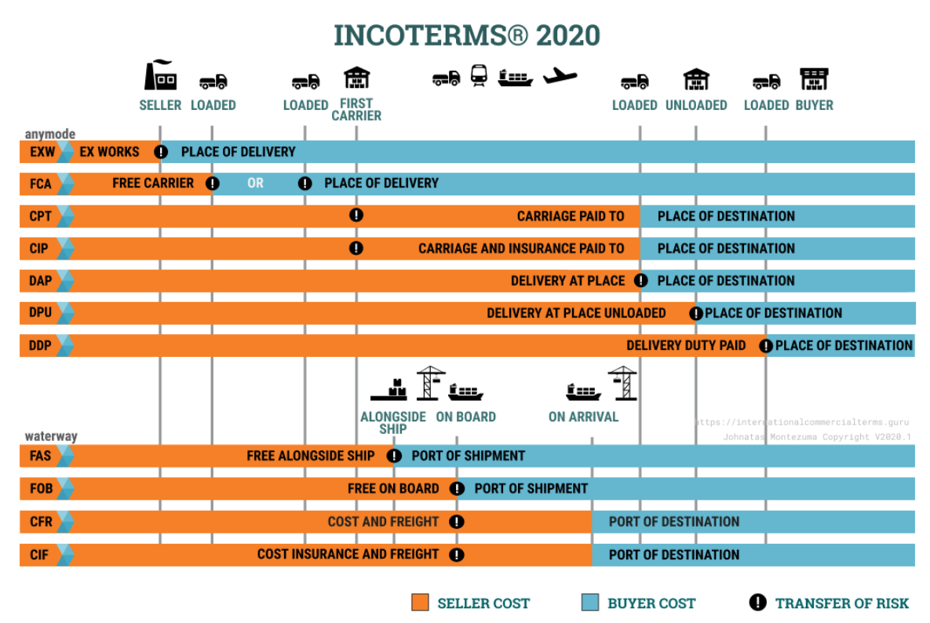

Slide 5
1.Rules for Any Mode or Modes of Transport（すべての輸送手段に適した規則）
EXW (Ex Works) Shipping terms ex-factory. The seller transfers the goods to the buyer at the seller's premises (factory), and the buyer is responsible for all freight, insurance premiums, and risks thereafter.
FCA (Free Carrier) Carrier delivery conditions. The seller will bear all costs and risks until the goods are delivered to the carrier at the designated location (container yard at the loading point, etc.), and the buyer will bear the freight, insurance premiums, and risks thereafter.
CPT (Carriage Paid To) Conditions including transportation costs. The seller bears the risk and sea freight costs until the goods are delivered to the carrier at the specified location (container yard, loading port, etc.), and the buyer bears the costs and risks thereafter. Although CPT terms do not specify who provides the insurance, it is usually the buyer who bears the risk.
CIP (Carriage and Insurance Paid To) Conditions including transportation costs. The seller bears the risks, sea freight, and insurance premiums until the goods are delivered to the carrier at the designated location (container yard, loading port, etc.), and the buyer bears the costs and risks from the point of unloading.

Slide 6
DAP (Delivery at Place) – Delivery at Destination (Designated Destination) The seller's burden of risk and expense changes when the seller is ready to hand over the cargo to the buyer (importer) on the means of transportation (ship, plane, truck) that arrived. Under the terms of the DAP, the seller must bear all risks associated with delivery of the goods.
DPU (Delivery at Place Unloaded) – Unloading Delivery (Designated Destination) The Incoterm rules require the seller to deliver the goods after unloading at a designated location. The Seller shall bear all costs associated with transportation (export fees, freight charges, unloading from the major transport company at the port of destination, and port of destination fees) and assume all risks until arrival at the destination.
DDP (Delivered Duty Paid) Conditions including delivery and duty at destination. The seller bears all costs (including import duties) and risks until the goods are delivered to the designated destination.

Slide 7
2. Rules for Sea and Inland Waterway Transport（海上及び内陸水路運送のための規則）
FAS (Free Alongside Ship) Shipping conditions. The seller will bear the cost of loading the cargo onto the side of the ship at the port of loading, and the subsequent costs and risks will be borne by the buyer (the seller is not required to load the cargo onto the ship).
FOB (Free On Board) Terms of delivery on deck. The seller will bear the costs of [Note 7] until the cargo is loaded onto the vessel at the port of loading, and the costs and risks thereafter will be borne by the buyer.
CFR (C&F Cost and Freight) Conditions including freight. The seller will bear the costs and sea freight costs until the cargo is loaded onto the vessel at the port of loading, and the insurance premium and risks thereafter will be borne by the buyer. It was called C&F until the Incoterms revision in 1990, and it is still sometimes called C&F.
CIF (Cost, Insurance and Freight) Conditions include freight and insurance. The seller will bear the cost of [Note 7] until the cargo is loaded onto the vessel at the port of loading, the sea freight and insurance premiums to the destination, and the risk thereafter will be borne by the buyer.

Slide 8
Q&A in English
Q1: Please tell us the name of your company.
Q2: Which department do you belong to?
Q3: What kind of work do you do every day?
Q 4: What is your boss's name?

Slide 9
Q&A in Japanese (日本語訳)
Q1: あなたの会社の名前を教えてください。
A:
Q2: あなたはどこの部署に所属していますか？
A:
Q3: あなたは毎日どのようなお仕事をしていますか？
A:
Q 4 : あなたの上司のお名前は何という名前ですか？
A:

Slide 10
Q&A in Japanese
Q5: How many items are there in Incoterms 2020?
( How many types of trade terms are specified in Incoterms 2020?)
A:
（Sample）Q6: What does Incoterms stand for? (What does Incoterms mean?)
A: Incoterms is an abbreviation for International Commercial Terms.

Slide 11
Q&A in Japanese
Q５：Incoterms 2020にはいくつのアイテムがありますか？
( Incoterms 2020で規定されている貿易条件は何種類ありますか？)
A:
Q6: Incoterms とは何の略でしょうか？(Incoterms とは何を意味していますか？
A: インコタームスとはInternational Commercial Termsの略です。

